Slide 1

Developer’s Test

Slide 2
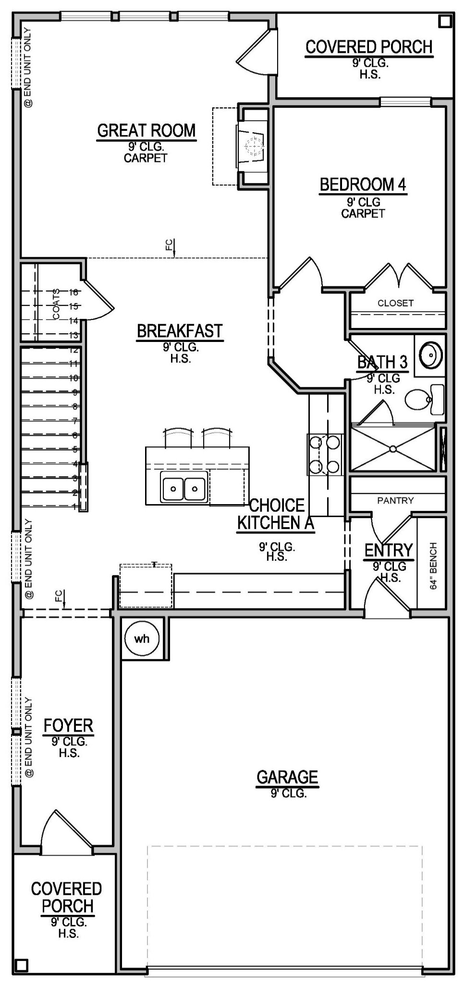
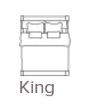
Build a sample interactive webpage
Drag & Drop and Rotate over this image
Apply Rotate, Vertical and Horizonal flip.
Option to Resize the image with inputs for length and width

Slide 3
Instructions
Need a simple page layout with the elements below (refer the previous slide)
Sample plan
Furniture select
Move the furniture element with Drag and Drop over the floor plan
Apply Rotate, Vertical and Horizonal flip to the furniture element
Implement other functionalities as per your idea to make it creative and make a difference
Sample link - https://www.beazer.com/houston-TX/ashbel-cove-/landmark-collection-/berkshire [See the Floor Plan section >> ‘Place Furniture’]

Slide 4
Deliverables
Create a folder with name – “Your Name – Sample Interactive Webpage”
Name the main page – “your-name-sample-iw.(html/php/none)”
Store all other files into the folder
Zip the folder
Deliver the folder

